Slide 1
Naval STEM
Science, Technology, Engineering & Mathematics
Notes:
When you think of the Navy, what comes to mind?
Our Navy works from the depths of the ocean to the limits of space and everywhere in between.
Working in all of these environments requires a diverse group of skilled professionals to ensure that the Navy is always prepared and one step ahead of our adversaries.
Science, technology, engineering, and math are all vital components of the work we do.

Slide 2
DoN S&T
“A ship in port is safe, but this is not what ships are built for. Sail out to sea and do new things.”
Admiral Grace Hopper
Computer Scientist
Notes:
The Navy is on the cutting edge of science and technology research.
To stay on the cutting edge, the Navy needs professionals with backgrounds in STEM fields to:
Conduct and manage science and technology research,
Lead development, testing, and evaluation of new technologies and systems
Maintain and evolve existing systems

Slide 3
Science
S
T
E
M
Notes:
The Navy needs professionals with science background to:
Provide medical care
Serve as authorities in the fields of oceanography and meteorology
Conduct research in our labs
Naval Science jobs include:
Microbiologist
Medical Professionals
Submarine and Surface Warfare Officers
Aerospace Physiologists
Biochemists, Biophysicists, and Chemists
Entomologists
Psychologists
Oceanographers and Meteorologists

Slide 4
Technology
S
T
E
M
Notes:
The Navy needs professionals with technology backgrounds to:
Develop unmanned systems and robotics that keep people out of harm’s way
Eliminate computer-based threats
Naval Technology jobs include:
Intelligence Specialists
Information Professionals
Naval Reactors Engineers
EOD Technicians
Electronics and Sonar Technicians
Cryptologists
Navy Divers and SEALS
Software Developers and Systems Analysts

Slide 5
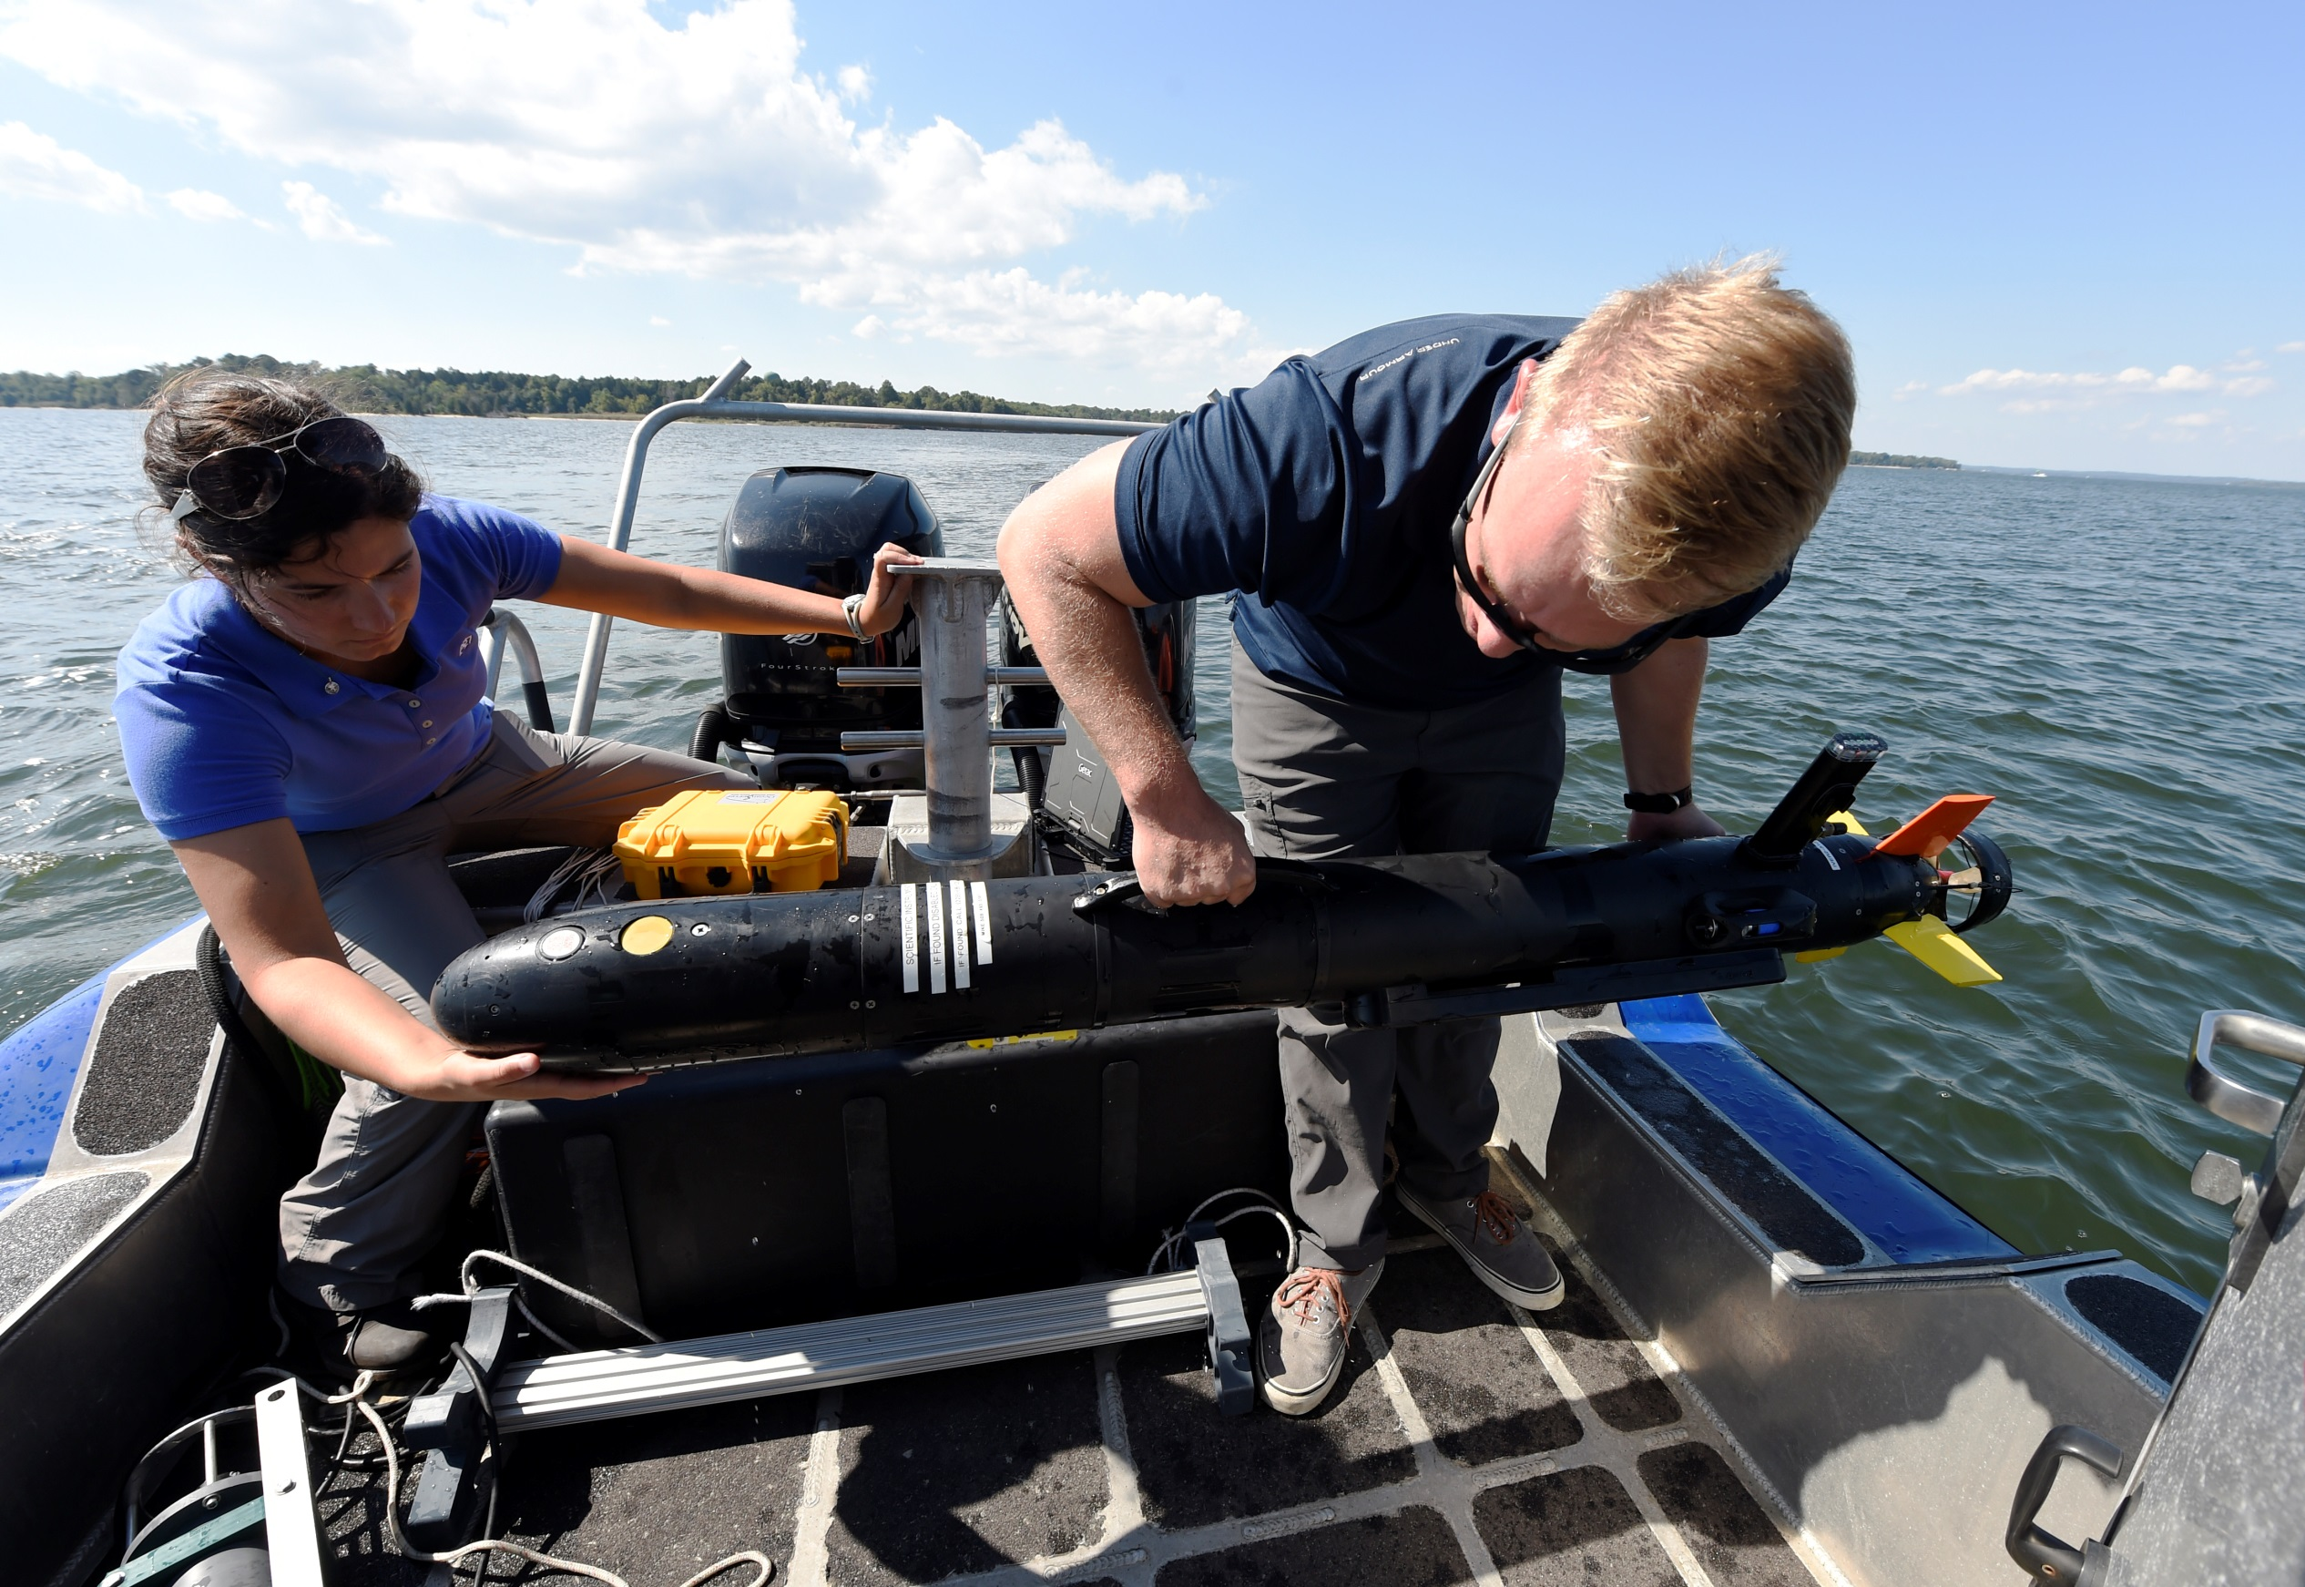
Engineering
S
T
E
M
Notes:
The Navy needs professionals with engineering backgrounds to:
Oversee unique construction projects
Design, build, and maintain our ships, submarines, aircraft and weapons systems
Naval Engineering jobs include:
Nuclear Engineer and Nuclear Operations Technician
Civil, Electrical, and Mechanical Engineers
Naval Architect and Marine Engineer
Marine Architect
Automotive Engineer and Technicians

Slide 6
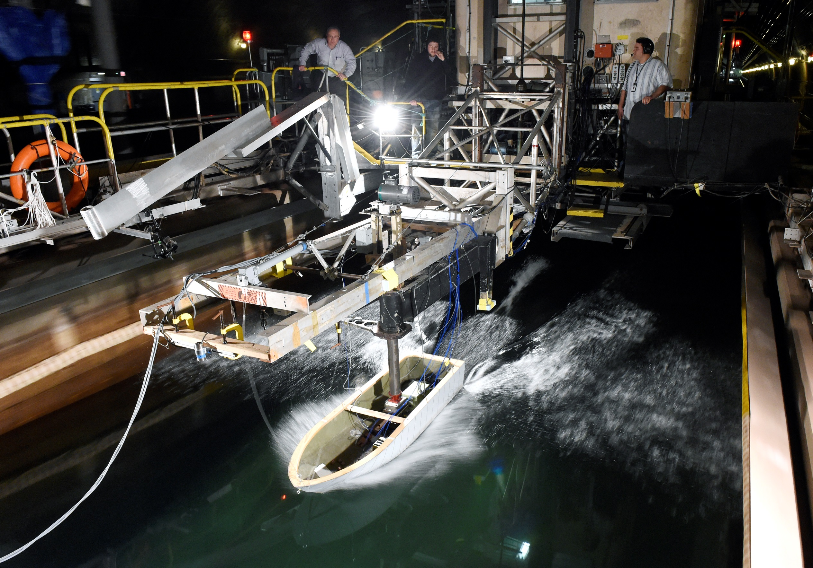
Mathematics
S
T
E
M
Notes:
The Navy needs professionals with math backgrounds to:
Analyze intelligence that is vital to national security
Interpret data and apply data to real-world situations to improve performance of technologies and systems
Expand knowledge rooted in either the theoretical or applied
Naval Math jobs include:
Intelligence Specialist
Computer Science Technician
Purchasing, Supply and Logistics Professionals
Naval Reactors Engineer
Risk Management Specialist

Slide 7
Navy STEM Professionals are:
Notes:
Our people include:
Civilian scientists, engineers, technicians, managers and support staff
Uniformed personnel
Reservists
Student interns and faculty on sabbatical from their colleges and universities

Slide 8
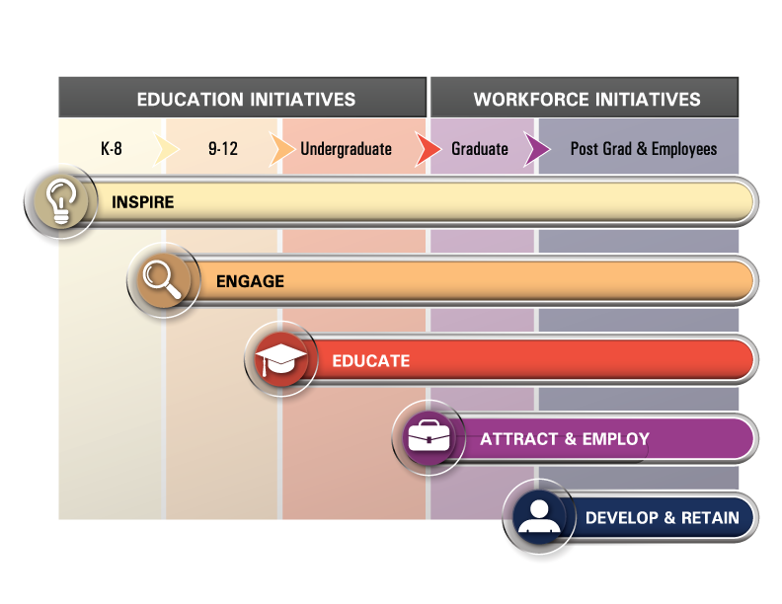
Naval STEM Vision:
To foster and cultivate a diverse, world-class STEM workforce in order to maintain the U.S. Navy and Marine Corps’ technological superiority.
Notes:
Naval STEM has opportunities for people of all ages and experience levels:
Inspire: short-duration outreach engagements such as festivals, demos and expos to introduce participants to naval-relevant STEM content, skills, and careers
Engage: hands-on activities and experiences for students and teachers, including classroom and extracurricular activities
Educate: curricula and degree programs for students as well as certifications and further education opportunities for the current workforce
Attract and Employ: internships and other employment opportunities engaging students and professionals with the naval S&T research network
Develop and Retain: opportunities to improve professional skills for the current DoN workforce

Slide 9
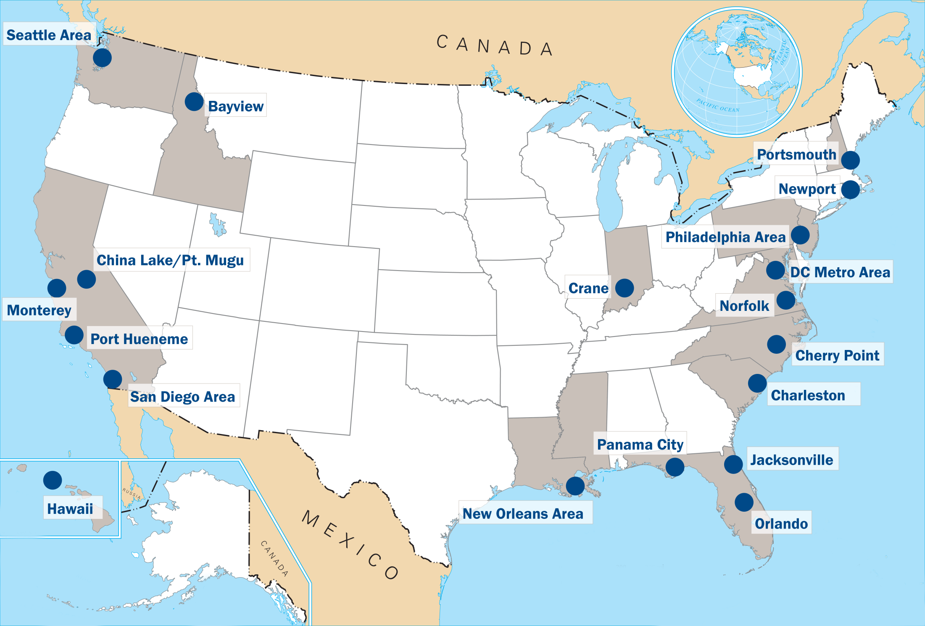
Geographic reach
Naval STEM Programs are active across the U.S.
Notes:
Naval commands around the world work on S&T and offer STEM programs and opportunities for local communities
The sites shown on this map have active Naval STEM programs
Contact your local facility for more information or to learn about how you might be able to engage with the facility and their scientists and engineers

Slide 10
Naval STEM programs and opportunities include:
Festivals, Expos & Demos
Classroom &
Extracurricular Activities
Internships & Mentorships
Teacher Trainings

Slide 11
Visit the Naval STEM Website: http://navalstem.navylive.dodlive.mil
Contact the Naval STEM team
to share your ideas, experience, or to learn more!
Naval_STEM@navy.mil

